Slide 1
Enlightenment 1700s

Slide 2
The Intellectual movement first began in France, England, Scotland and Germany. It is sometimes referred to as the Age of Reason.
Enlightenment thinkers tried to apply scientific reasoning to understand people and to improve society through reform
Challenged divine right of kings, noble privilege, and the power of the Catholic Church

Slide 3
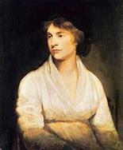
The spark for the Enlightenment came from the progress made by the Scientific Revolution. Enlightenment thinkers believed that by applying scientific reasoning, people could better understand both nature and one another. They believed that nature and society operated according to certain basic laws which they called “natural laws.”
Mary Wollstonecraft

Slide 4
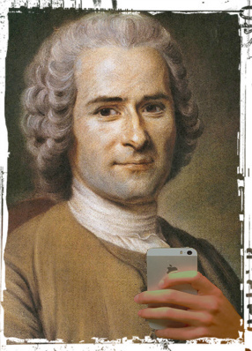
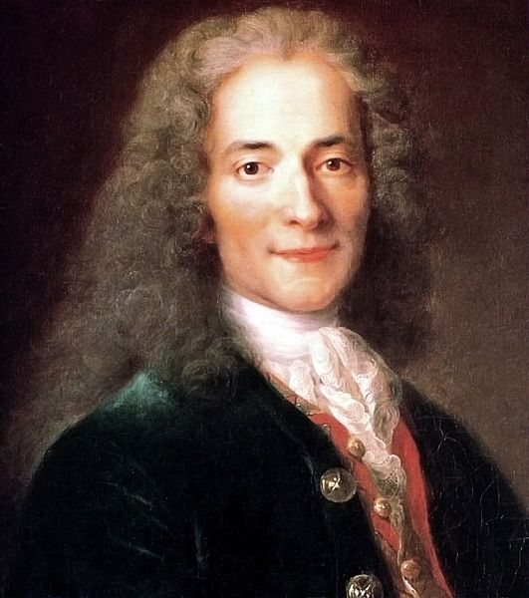
They applied the new scientific method to society and its problems, resulting in questioning the divine right of kings, the privileges of the nobility, and the power of the Catholic Church. The ideas of the Enlightenment transformed Europe and the rest of the world for centuries to come.
Jean-Jacques Rousseau
Voltaire

