Slide 1
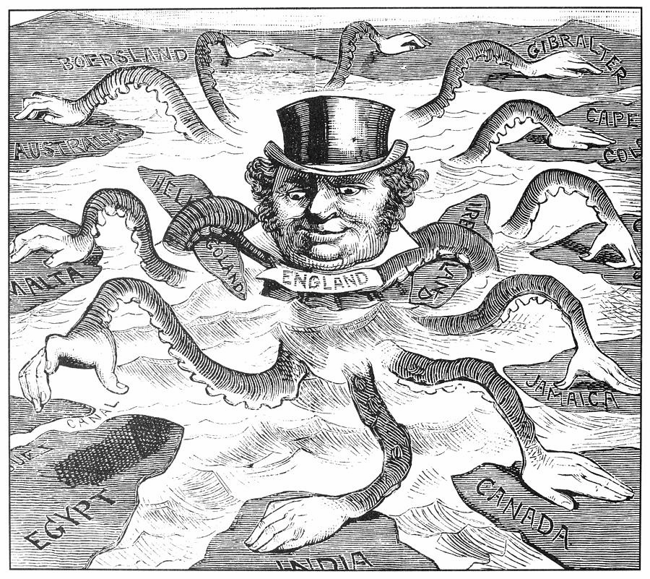
IMPERIALISM

Slide 3
IMPERIALISM
IMPERIALISM is the domination of one country of the political, economic, or cultural life of another country or region.

Slide 4
Overview
From the mid-1800s through the first decades of the 1900’s, western nations pursued an aggressive policy of expansion. European powers were motivated by economic, political, and social factors as well as by a strong sense of nationalism. During this time Britain took control of India. In Africa, several European nations engaged in a scramble for colonies. Meanwhile, imperialistic nations forced unequal trade agreements on China. Imperialism had many immediate and long-term effects on the colonial nations and also had an impact on Europe and the rest of the world. Imperialism led to increased competition and conflict.

Slide 5
Causes of Imperialism
Several important factors combined to lead to the development of the new imperialism.
Technology
New technology, such as steamships, rifels, telegraphs, railroads,
and better medicines, made it possible to penetrate deeply
into Africa, Asia and the Pacific for the first time.

Slide 6
Causes of Imperialism
Several important factors combined to lead to the development of the new imperialism.
Economic Motives
European industries needed raw materials to keep their factories
busy. Industrialists also sought new markets in which to sell their
manufauted goods.

Slide 7
Causes of Imperialism
Several important factors combined to lead to the development of the new imperialism.
National Pride
Imperialism represented an expression of nationalism. European
Countries wanted to acquire colonies to demonstrate their power,
prestige, and national superiority.

Slide 8
Causes of Imperialism
Several important factors combined to lead to the development of the new imperialism.
Balance of Power
European countries sought to preserve the balance among
themselves with regard to colonies. When one country obtained
a new colony, other European powers felt it necessary to do
the same.

Slide 9
Causes of Imperialism
Several important factors combined to lead to the development of the new imperialism.
Other Motives
Many Europeans believed in Social Darwinism – a theory that
technologically advanced societyies were more successful than
others because their cultures were superior. Others wanted to
spread Christianity.

Slide 10
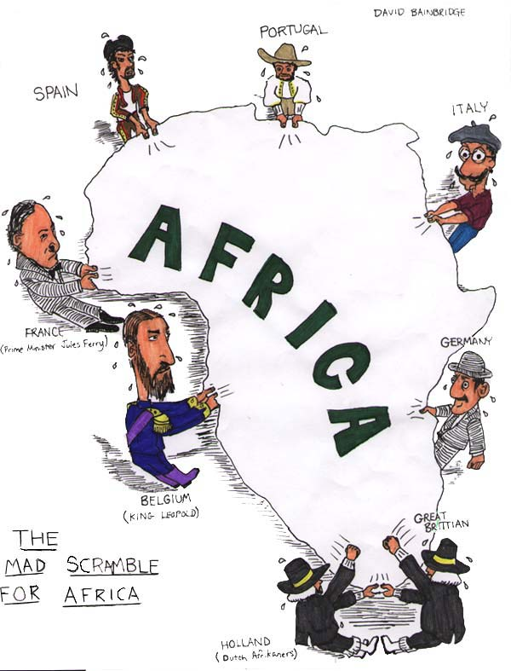
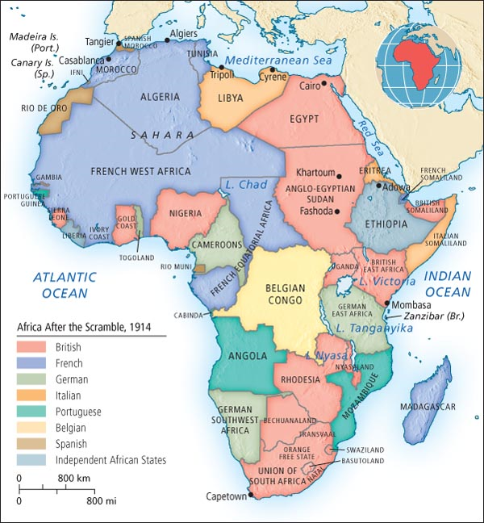

Slide 11
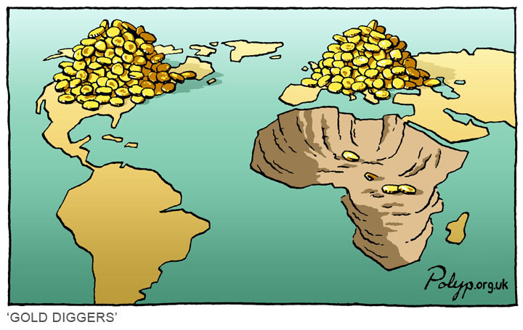
THE SCRAMBLE FOR AFRICA
In the 1870s, King Leopold of Belgium sent a mission to the interior of Africa to establish trade agreements with leaders in the Congo River basin. The Belgian presence in the Congo set off a scramble among other European powers to establish their presence on the continent.

Slide 12
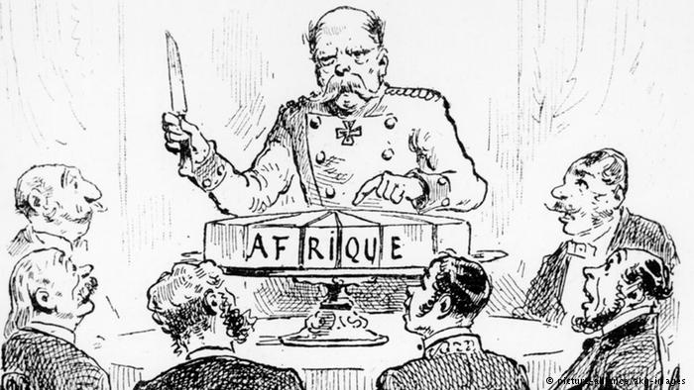
THE BERLIN CONFERENCE
In 1884, to avoid conflict among themselves, European leaders met in Berlin, Germany, to set up rules for colonizing Africa. European powers divided Africa with little regard for the people who lived there. The new imperialism affected Africa strongly. In 1850, most of Africa had been free. Seventy years later, most of the continent was under European rule.

Slide 13
Before the Scramble:
1600’s Boers (Dutch farmers) settled in S. Africa; British acquired the Cape Colony from the Dutch in 1815.
Boers, resenting British rule, migrated north, coming into conflict with Zulus (led by Shaka) for years. Zulus came into conflict with the British as well.

Slide 14
As the scramble begins:
In the late 1800s, Britain decided to annex the Bore republics. The Boers resisted and the Bore War began, lasting from 1899- 1902.
By 1914 almost all of Africa is divided among European nations and becomes economically dependent on Europe

Slide 15
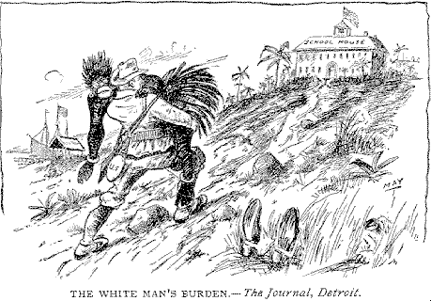
WHITE MAN’S BURDEN

Slide 16
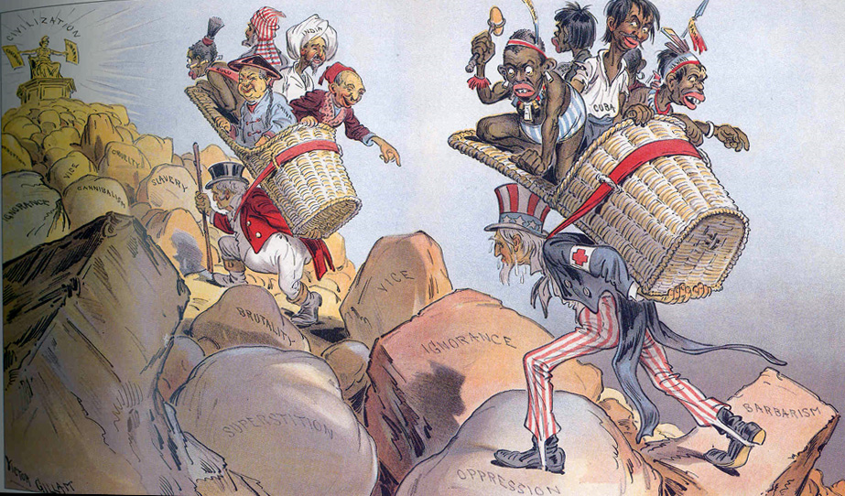
Rudyard Kipling’s poem “White Man’s Burden” offered a justification for imperialism. Kipling expressed the idea that white imperialists had a moral duty to educate people in nations they considered less developed.

Slide 17
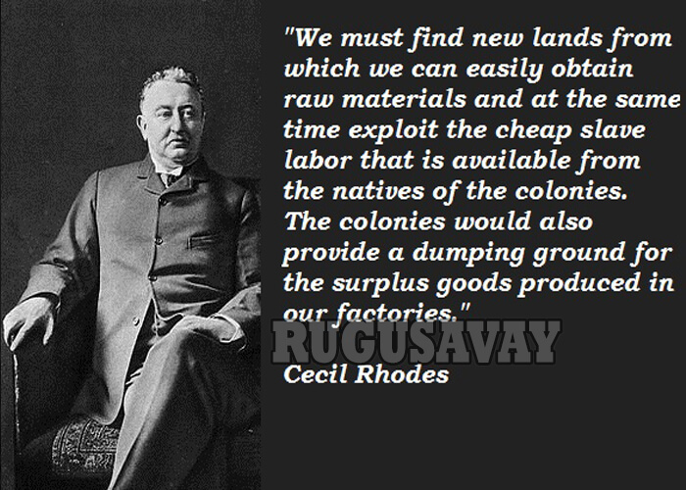
Cecil Rhodes became one the richest men in the world because of diamond and gold mining. His real interest was in power. Rhodes had an entire British colony named after himself- Rhodesia (now Zimbabwe). He also promoted the policy of the separation of races in southern Africa.

Slide 18
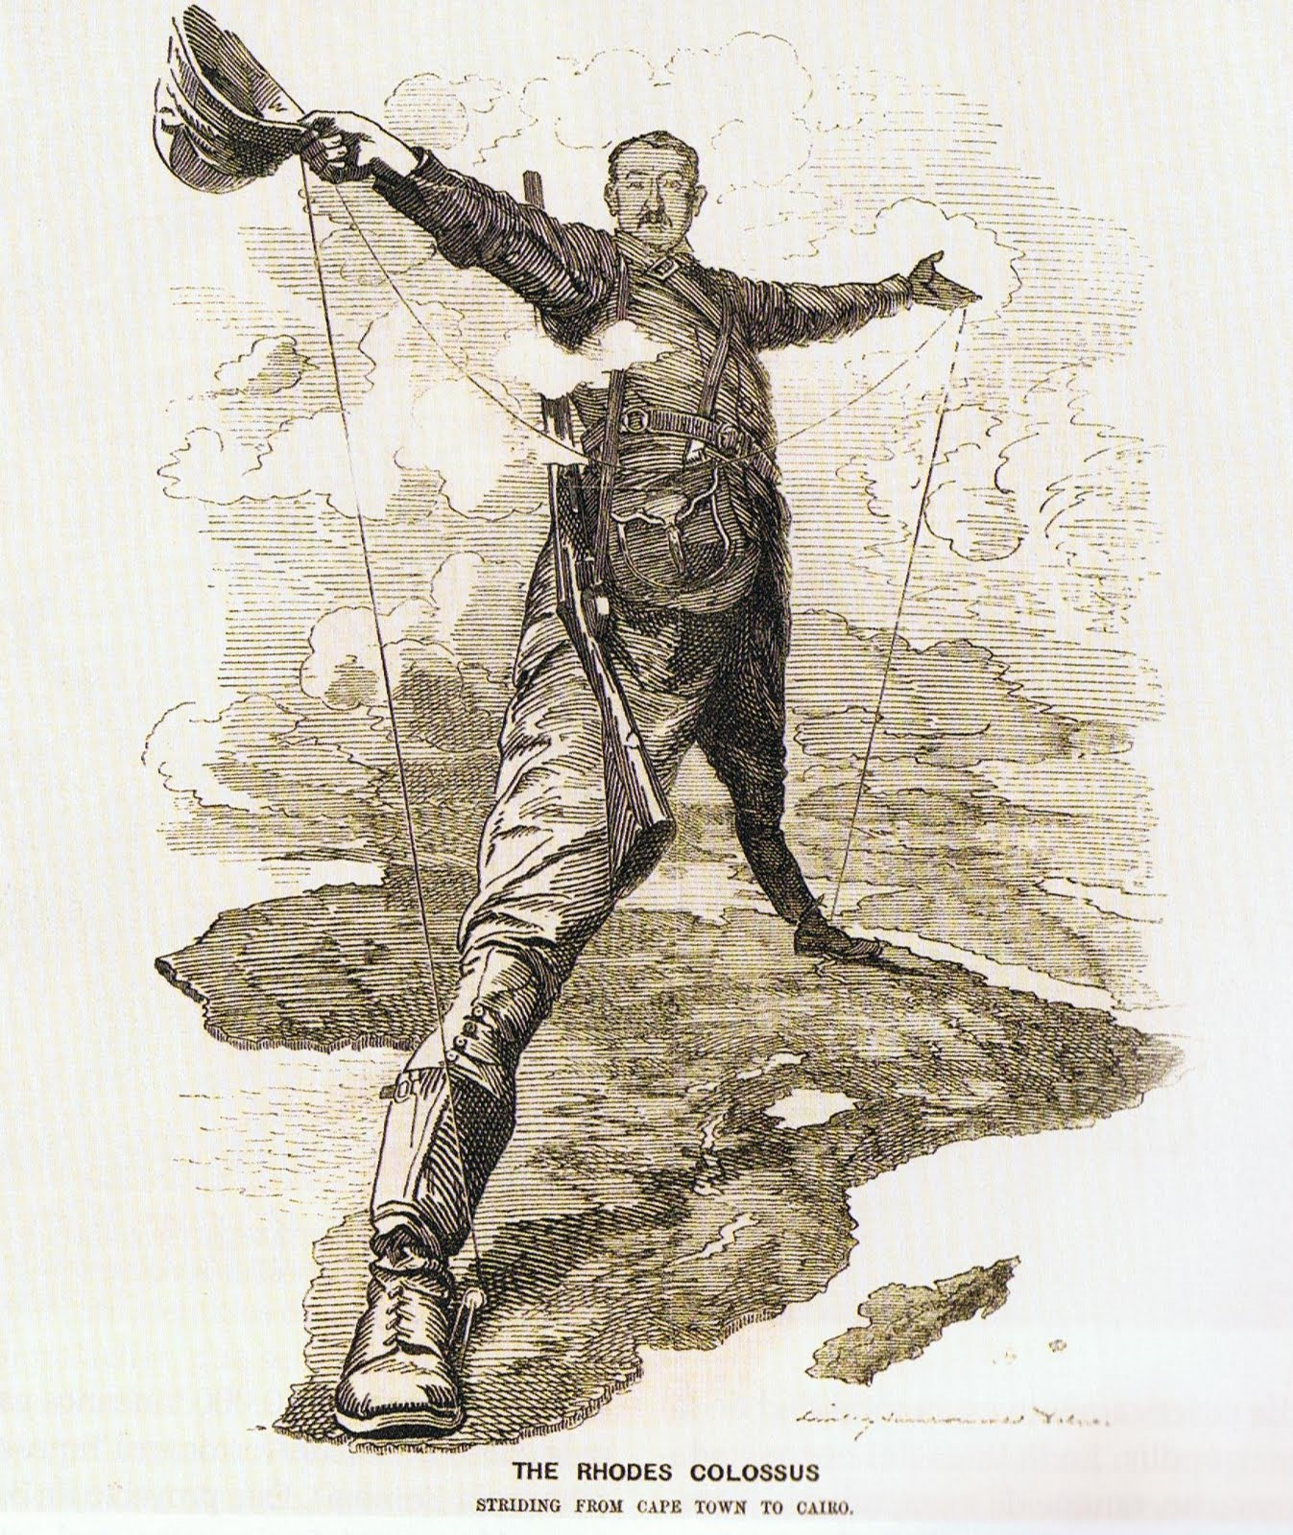
The Rhodes Colossus
Striding from Cape Town to Cairo

Slide 19
EFFECTS OF IMPERALISM IN AFRICA
In partitioning Africa, European powers paid no attention to existing tribal boundaries. They claimed ownership of the land, and wherever possible established mining operations or cultivated cash crops to be sold in Europe. Africans were used as a cheap workforce. On the other hand, Europeans introduced Western technology and ideas. Therefore, colonization had both positive and negative effects on Africa:

Slide 20
POSITIVE EFFECTS
NEGATIVE EFFECTS
European medicine and improved nutrition increased the life span of Africans. This also led to an expansion of the population.
Europeans introduced modern transportation and communications, such as telegraphs, railroads, steamships and telephones.
A small minority of Africans received improved educations and greater economic opportunities. Some served as administrators or in the army.
European domination often led to an erosion of traditional African values and destroyed many existing social relationships.
African peoples were treated as inferior to Europeans. Native peoples were forced to work long hours for low pay.
Europeans divided up Africa artificially, ignoring tribal, ethic, and cultural boundaries. These divisions have led to ongoing tribal clashes in many African countries.

Slide 21
ANTI-SLAVE TRADE LEGISLATION
Most European powers had abolished the slave trade before the scramble for African colonies began. For example, Denmark passed anti-slave trade legislation in 1803, followed by Britain in 1807, and France in 1818. Illegal slave trading, however, continued throughout the 1800s.

