Slide 1
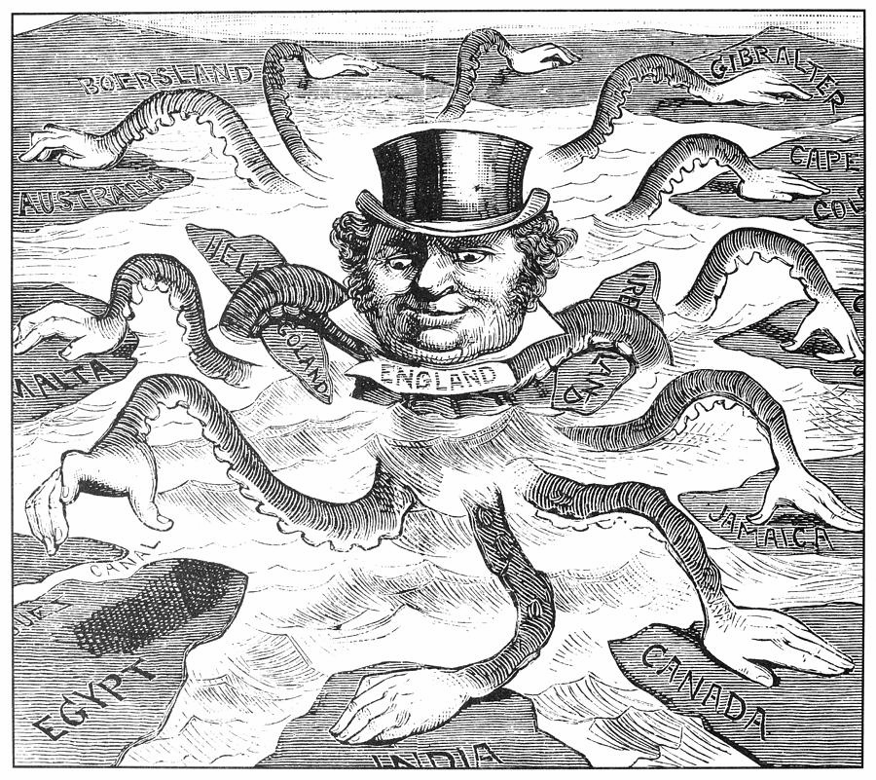
IMPERIALISM

Slide 2
THE BRITISH EMPIRE IN INDIA
British East India Company had established trading rights in India in the early 1600s. The company’s main objective was to make a profit for shareholders by exploiting the abundant natural resources and gaining access to the markets in India. By the mid 1800s, this company controlled three fifths of India. The company employed Indian soldiers, called sepoys.

Slide 3
The Sepoy Mutiny
In 1857, tensions rose. The British had angered the sepoys by demanding that soldiers follow rules that were against their religious beliefs. The Sepoy Mutiny, or the Sepoy Rebellion, called for Hindus and Muslims to unite against the British. The British, however, crushed the revolt.
The Sepoy Mutiny left bitter feelings. It also caused the British to change their policies. In 1858, Parliament ended the rule of the East India Company. The British government took direct command of India and sent more troops to India.

Slide 4
BAD EFFECTS
• Indian resources go to Britain
• British-made goods replace local goods
• Farms grow crash crops rather than food crops; Indians go hungry
• Top jobs go to the British
• Indians are treated as inferiors
• Britain tries to replace Indian culture with western ways
GOOD EFFECTS
• New roads and railroads link parts of India
• Telegraph and postal systems unite people
• Irrigation systems improve farming
• New laws mean justice for all classes
• Customs that threaten human rights are ended

Slide 5
All of India united for the first time under one political system. In 1885, a group of educated Indians formed the Indian National Congress. Some view this as the first act of Indian independence, which would not be achieved until after WWII with the formation of the countries of India and Pakistan.

Slide 6
IMPERIALISM IN CHINA
In the early 1800s, the British treasury was being depleted due to its dependence upon imported tea from China. The Chinese still considered their nation to be the Middle Kingdom, and therefore viewed the goods the Europeans brought to trade with as nearly worthless trinkets. To solve this trade imbalance Britain imported opium processed from poppy plants grown in the Crown Colony of India, into China.

Slide 7
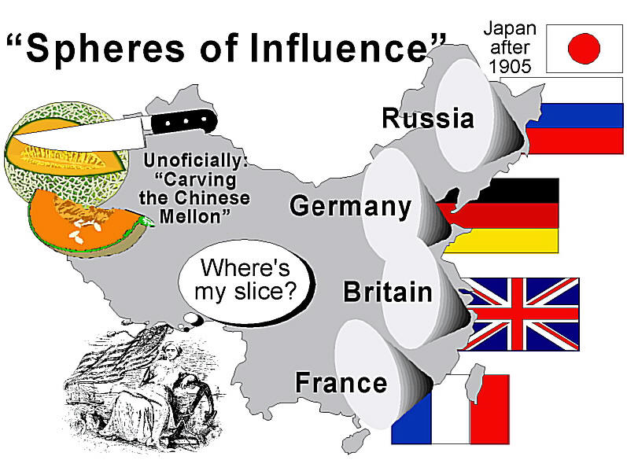

Slide 8
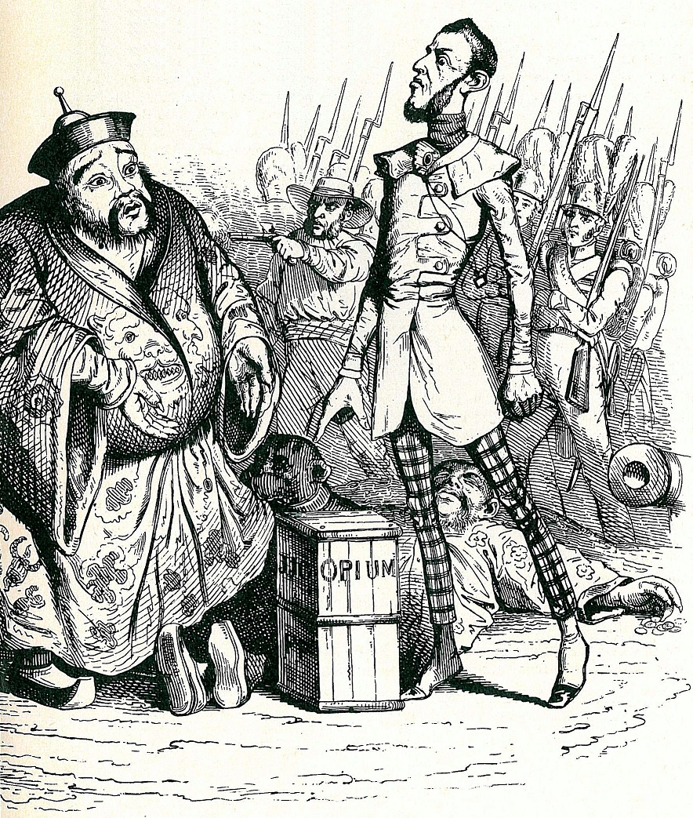
Opium War
China tried to halt imports of the addictive drug by destroying a British shipment of opium. In 1839, to keep trade open, the British fought with China in a conflict called the Opium War..

Slide 9
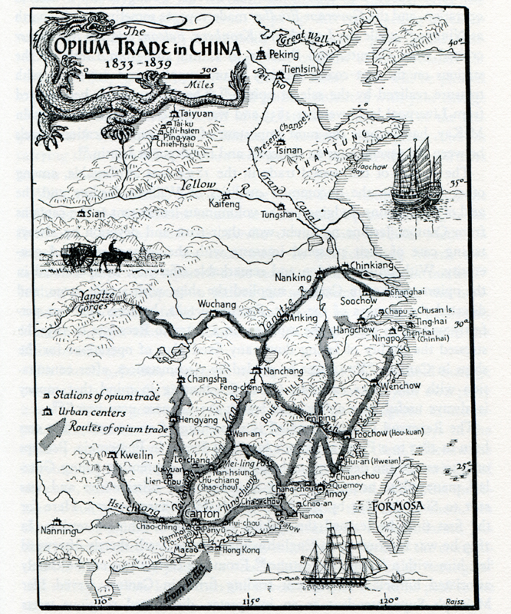
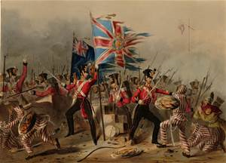

Slide 10
In 1842, Britain forced China to agree to the harsh terms of the Treaty of Nanjing. China had to pay for Britain’s war costs, open ports to British trade, and give Britain the island of Hong Kong. China also had to grant British citizens’ extraterritoriality, the right to live under their own laws and be tried in their own courts. In the years that followed, other western powers forced China to sign unequal treaties. The western powers carved out spheres of influence, areas in which an outside power claimed exclusive trade privileges.

Slide 11
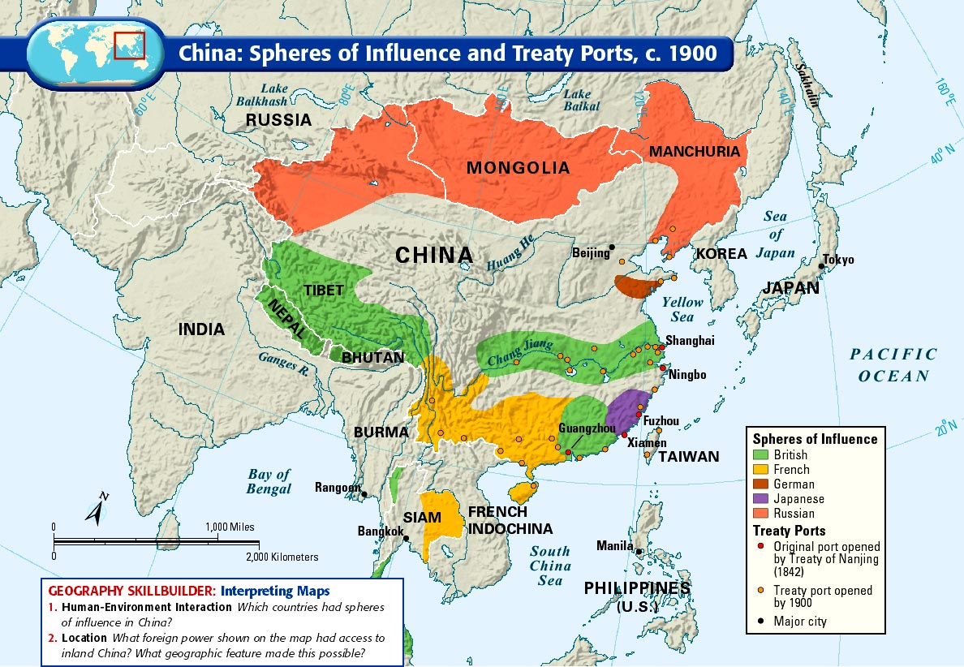

Slide 12
Unequal Treaties
According to the 1842 Treaty of Nanjing, the Chinese were to:
• Reimburse Britain for costs incurred fighting the Chinese
• Open several ports to British trade
• Provide Britain with complete control of Hong Kong
• Grant extraterritoriality to British citizens living in China

Slide 13
Chinese Reaction
Disgusted with the failed efforts of the Manchu Dynasty in ridding China of opium or foreign influence after the Opium Wars, Chinese citizens staged the Taiping Rebellion between 1850-1864. Already weakened, the Chinese officials turned to foreigners for help in putting down the rebellion, killing millions of Chinese and weakened China in the process.

Slide 14
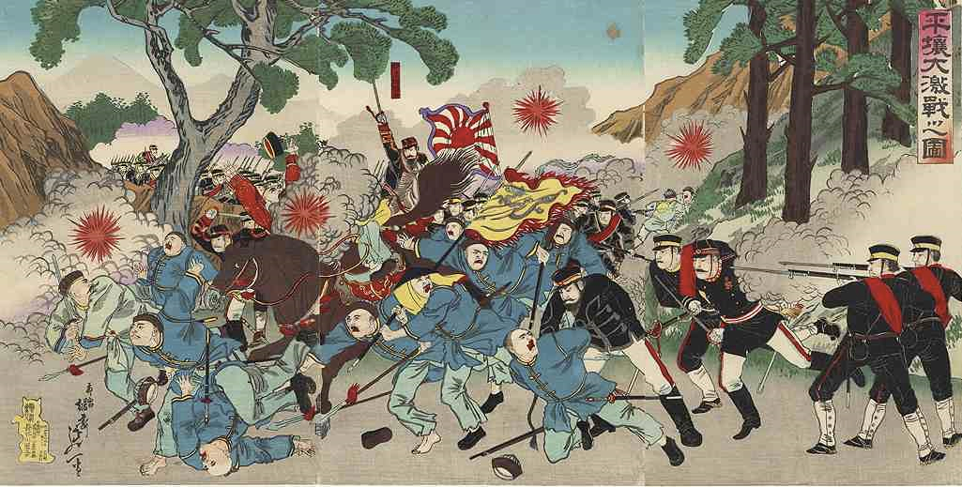
Sino-Japanese War (1894 – 1895)
Sensing China’s weakness, Japan also went to war with China and quickly defeated it. Japan then annexed Korea and created its own sphere of influence in China.

Slide 15
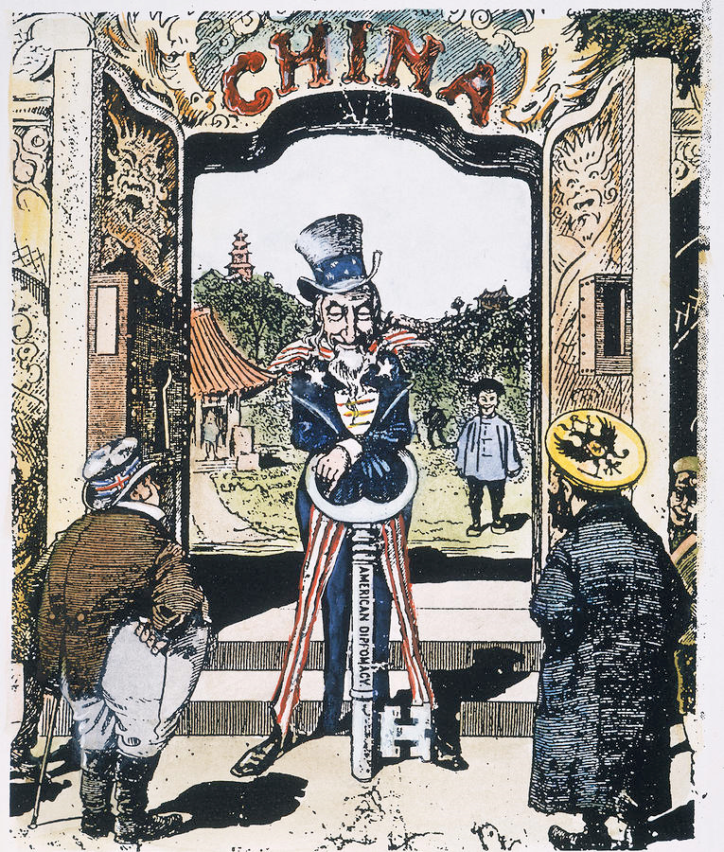
Open Door Policy
In 1899, fearing it would be shut off from China’s profitable trade, the U.S. proposed equal trading rights for all nations in China. American policy discouraged European powers from further dividing up China, and kept it “open” to trade with all nations.

