Slide 1
MIDDLE EAST

Slide 2
The Arab-Israeli Conflict “One Land, Two People”
Palestine-today part of Israel
Homeland
Zionism- movement of Jews to return to their homeland, Israel
Arab Nationalism - desire to establish their own home in Palestine
Nationalism- love for your country
Conflict between Arabs and Jews
Palestine - today part of Israel
Both groups see Palestine as a historic & religious homeland
Both want to establish an independent nation on this land

Slide 3
Balfour Declaration
Written in 1917 by Lord Balfour during WWI promise made to both Arabs & Jews
Britain wants to strengthen war effort to defeat Ottoman Empire (Turks).
Before WWI, Britain makes promises to the Arabs if they help in British war against Germany Arabs would be given freedom after war.(they were part of the Ottoman Empire who ruled over the Arabs.)

Slide 4
Balfour Declaration
Balfour Declaration states that Jews should establish their “national home” in Palestine. But not violate the rights of Arabs.
CONFLICT and MORE FRICTION
-Britain takes Palestine & takes away its support for a Jewish State
WWII-extermination of Jews-Holocaust-many Jews seek refuge in Palestine

Slide 5
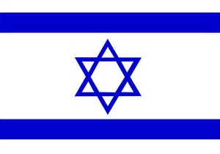
Balfour Declaration
Same time several Arab nations formed the Arab League- set out to defend the Arab cause in Palestine
-1947-UN feels that Palestine should be split into 2 parts- a Jewish state and Arab state.
-Jews agree but Arabs disagree- fighting begins-Jews win their independence and in 1948 the state of Israel was proclaimed. Israel is a democratic nation.

Slide 6
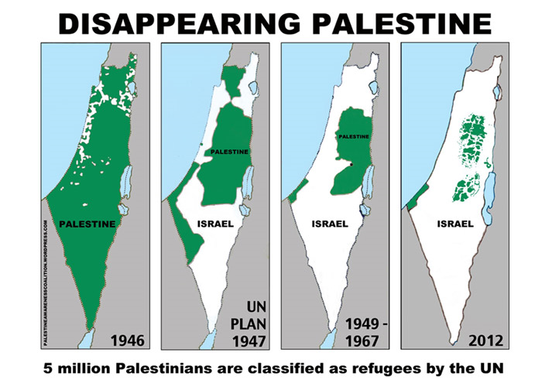

Slide 7
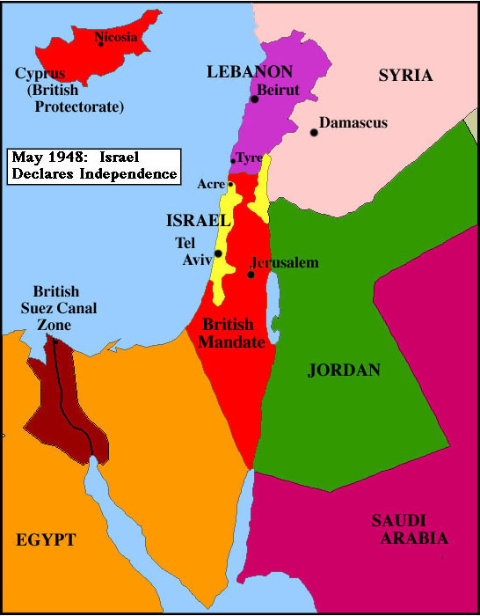
What has been the results of the Arab-Israeli Conflict?
4 major wars have been fought between Israel and Arab nations around it (Egypt, Jordan, Syria, Lebanon, Saudi Arabia)

Slide 9
What has been the results of the Arab-Israeli Conflict?
1. Independence War in 1948-
2. Suez Canal Crisis-1956
-Nasser (King of Egypt) “nationalized” the Suez Canal (took it over-denies Israel access-to finance dam). Britain owned but it was an international waterway
*Arab see this as a right to control their own land-conflict-Jews see it as a dictator cutting off vital areas for trade.
Britain, France & Israel defeat Egypt
U.S. & USSR disapprove- withdraw-
Canal in the hands of Egypt.

Slide 10
What has been the results of the Arab-Israeli Conflict?
3. Six-Day War (1967) many Palestinians under Israeli rule at end of
-Egypt & Jordan begun cutting off all ports to Israel-Israel attacks and wins big! Triple their land, Israelis win Gaza strip from Egypt, Golan Heights from Syria, & West Bank from Jordan.
***Biggest Problem of Wars-Arab Refugees-those who flee (1948 War increase) must be taken in by other Arab countries or go to UN refugee camps under Israeli control
-Bad conditions, riots-over 1 million under Israeli control after the 1967 war.

Slide 11
What has been the results of the Arab-Israeli Conflict?
-After the 6 day war, more and more Palestinian Groups came under on organization- PLO (Palestinian Liberation Organization)
Leader was Yassar Arafat-very radical group-TERRIORISM-

Slide 12
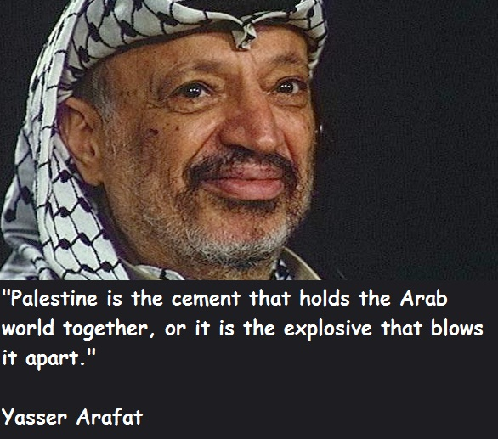

Slide 13
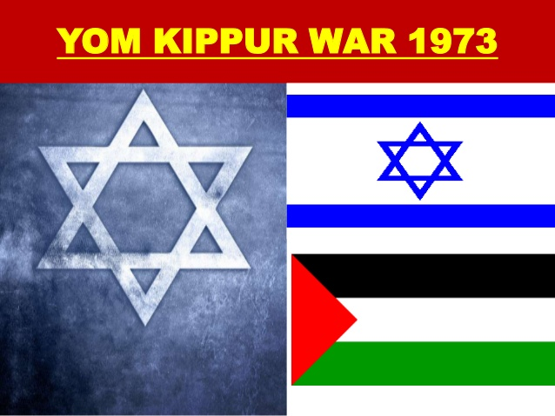
4. Yom Kippur War (1973)- on Yom Kippur & during Ramada-surprise attack
Egypt & Syria (supported by USSR) made surprise attacks on Israel- in Golan and Gaza- failed miserably they wanted land lost in 1967 war, U.S. support Israel- airlift, UN negotiated a cease-fire
1987-Intifada (Uprising)-Palestinian movement in the occupied territories to “throw off” Israeli rule.
(Stone throwing, strikes-attack troops and selected targets-workers strike-young people)
-Violence against Israeli soldiers
-Gaza strip-West Bank
*These actions focused world attention on Palestine

Slide 15
Growth of Arab Nationalism
1. Arab League- a response to Jewish Nationalism- Stop Zionism
2. Pan-Arabism (1953)
(Egypt & Syria joined together for 3 years into the United Arab Republic- didn’t last as Egypt took over)
-Arabs united by hatred of Israel but they are not really united-
-more loyal to their own country
-poor nations felt the rich would rule (mistrust)
-no trust (suspicious)- Ex. Persian Gulf War

Slide 16
Attempt to solve conflict
Camp David Accords (1979)
-set up full relations between Israel and Egypt (Menachem Begin-Egypt and Anwar Sadat-Israel)-President Jimmy Carter steps in when talks stall
*Egypt becomes first Arab nation to make peace with Israel and recognize their right to exist
*Israel give back Sinai Peninsular (taken in 1967 war).

Slide 17
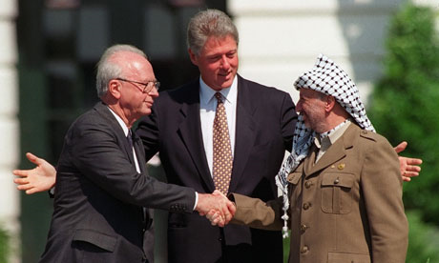
Attempt to solve conflict
Middle East Peace Conference (1993 Madrid, Spain)-led by U.S.- Israel Yitzhak Rabin and PLO Yasser Arafat
Main goal was to settle West Bank & Gaza Strip (Palestinians still there in Refugee camps
-Gaza given back in 1994-1995

Slide 18
What was the Iranian Revolution
1953-Iran ruled by Shah Reza Pahlavi (similar to Kemal Ataturk in Turkey) he did some positive things and he did some negative things
Positive
-Friendly with the West (U.S.)-good ally which vital to us in the Middle East for Oil
-Took steps to modernize & westernize the country
-Western style divorce
-Women urged to not wear veils in public
-New industry and New modern railroads
-Education a priority, literacy increases (western books)
-Movie theaters

Slide 19
What was the Iranian Revolution
Negative
Became a secular society (non-religious) -does not consult with religious figures / ignores the clergy’s point of view
Rules with absolute power had his own secret police-SAVAK-put down demonstrations violently to maintain order
1970’s-oil boom-large $ increases- Shah spends money on himself and leads a rich lifestyle
Gap between rich (few) and poor (many) grows larger (much corruption)
**People want change-Shah is Not meeting the needs of the people of Iran = REVOLUTION

Slide 20
What was the Iranian Revolution
Ayatollah Khomeini
Shi’ite Muslim’s are outspoken about Shah’s rule and broadcasts radio messages on underground radio stations
Forced the Shah to flee to France (or he would be in jail)- taped messages smuggled in and played in mosques.
1979 Iranian Revolution- violent overthrow of govt. Shah flees to Egypt and Khomeini is the new leader of Iran

Slide 21
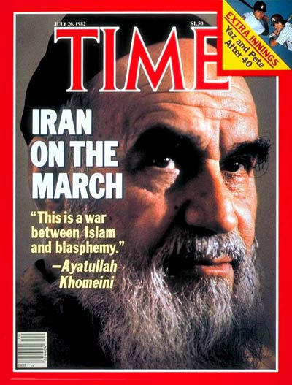
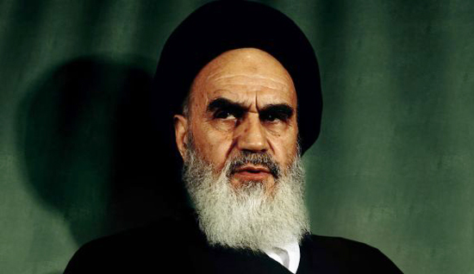
What was the Iranian Revolution
Ayatullah Khomeini

Slide 22
Effects of the Revolution
Islamic Republic
A Theocracy is set up- govt. where political and religious leaders are the same (go back to old ways)
-People follow Islamic Fundamentalism.-oppose westernization, reform to Islamic principles- Muslim religious tradition
-very strict interpretation of the Koran
-law of Islam will govern people
-no non-Islamic believers in office
-will try to spread beliefs through Middle East
Use terrorism to establish an Islamic republic

