Slide 1
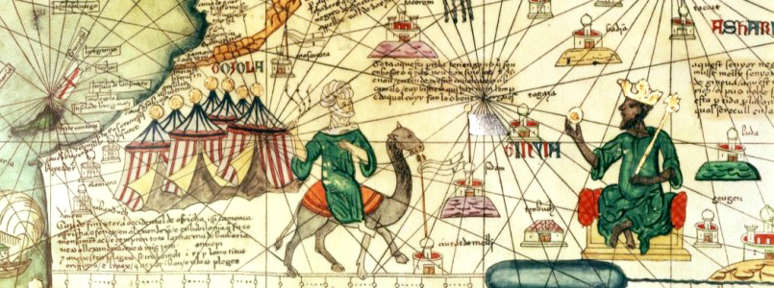
Vocabulary Opener

Slide 2
Argument
An explanation for a claim that uses evidence to support it

Slide 3
Audience
The person or group of
people that a message is
for

Slide 4
Author
Person or group who
created a source

Slide 5
Claim
An opinion supported by
evidence

Slide 6
Endure
Last for a long time

Slide 7
Evidence
Information or details from
a source that can be used
for a specific purpose
time

Slide 8
Explanation
A statement that makes
something understandable

Slide 9
History
An account of the past
constructed from
evidence

Slide 10
Issue
A challenge or problem

Slide 11
Limitation
Something that prevents
something; restriction

Slide 12
Purpose
Why something was
created; reason why
something was done

Slide 13
Significant
Important; a significant
Event in history had long
lasting effects on a lot of
people

