Slide 1
Reconstruction and Prosperity

Slide 2
The first years following WWI were not easy ones for Europe; they dealt with a famine, unemployment, and a deadly flu (The influenza pandemic of 1918-1919 killed between 20 and 50 million people).
Europe spent the next five years rebuilding.
Germany had to make huge payments to France and Britain, slowing their economic recovery.
American banks and industries began investing in Europe, American prosperity spread to Europe, Asia and Latin America.

Slide 3
Literature and Arts: The Lost Generation
WWI had left scars on those who survived. Writers, artists, and musicians throughout the 1920s and 1930s expressed a loss of hope and moral values. They became known as the “Lost Generation”.

Slide 4
Women’s Suffrage Movement
During the mid-1800s in western democracies, women had begun to demand greater rights. These include property right and suffrage. President Wilson proposed the Nineteenth Amendment in 1918. Congress ratified the amendment two years later gave American citizens over the age of 21 the right to vote, regardless of gender.

Slide 5
Causes of the Depression
Weaknesses in the economies of the United States and other nations around the world led to the Great Depression.
Industrial unemployment rates
INDUSTRIAL UNEMPLOYMENT RATES
COUNTRY | 1921-1929 | 1930-1938
United States United Kingdom France Germany | 7.9 12.0 3.8 9.2 | 26.1 15.4 10.2 21.8
Less demand for raw materials
Overproduction of manufactured goods
The stock market crash

Slide 6
The Great Depression (1929)
The stock market crash in New York started a chain of events that sent the American economy into a great depression.
American banks recalled their loans from Europe and the depression quickly spread worldwide.
About 40 million people were unemployed in major industrial nations such as United States, Japan, Germany, Great Britain, etc.

Slide 7
FASCISM & WORLD WAR II

Slide 8
FASCISM & WORLD WAR II
Fascism is the rule of a people by dictatorial government that is nationalistic and imperialistic. Fascist governments are also anti-communist. Fascism emerged in both Italy and Germany after World War I.
By 1939, only two major European states- Great Britain and France- remained democratic. Italy, the Soviet Union, Germany and many other states had dictatorial regimes.

Slide 9
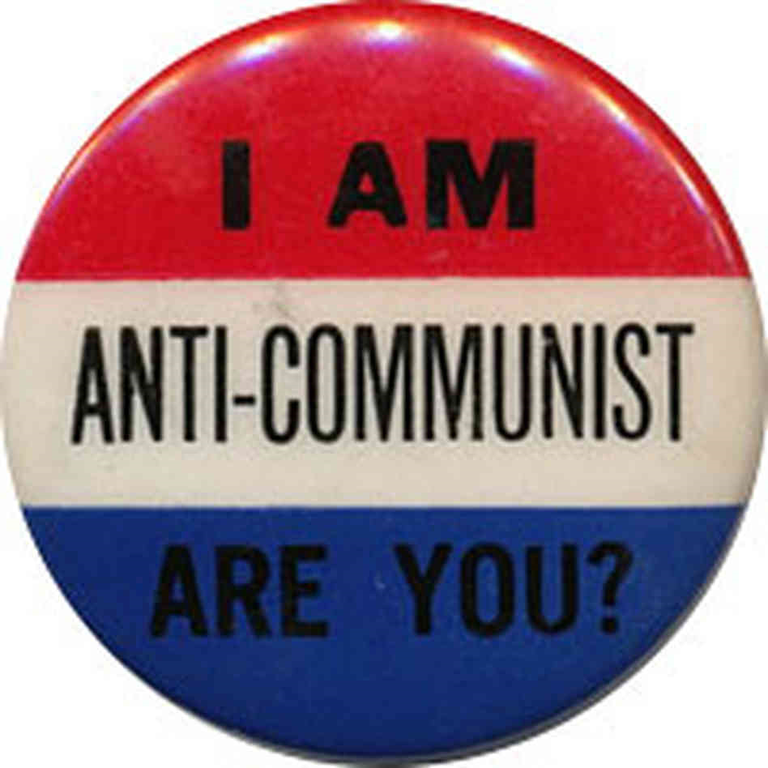
Anti-Communist- goals of state above individual rights- use violence and terror, strict discipline, extreme nationalism. Defend private ownership of property-but under government control. Another type of dictatorship -private ownership of all property and capital but government has strict control over people.

Slide 10
-Opposition within Germany to Hitler was stopped by the Gestapo-secret police
-Support was gained through Propaganda - newspaper articles, speeches, rallies, etc. (used art and education as tools for preaching obedience to the state)
-Government used censorship to control what people knew, heard, etc. All things (movies, radio, and news) promoted Nazism.
-1935 German Re-armament begins in violation of the Treaty of Versailles-
-Triples army from 100,000-300,000
-Compulsory military service
-Begins to build battleships, weapons

Slide 11
Fascism & Communism Differences
Main difference between Fascism & Communism is economies - view on ownership
Communism
Government ownership of all property/capital
Classless society
Both totalitarian/communism – no other political parties, censorship, denied civil rights
Fascism
Allowed private ownership of property
Wealth tolerable and classes acceptable
Dictator-person who has total, complete rule- don’t come to power by free election or by inherited right

Slide 12
The Roots of Fascism
Anti-Semitism (hatred of Jews)
The beliefs and customs of Jewish people made them easy targets in times of social unrest and economic difficulty.
Racism is contempt for other races.
Social Darwinism made racism and anti-Semitism respectable by applying Charles Darwin’s theory of evolution to human society.
Widespread economic despair paved the way for the rise of dictators. Strong leaders in Italy and Germany promised solutions.

Slide 13
Rise of Fascism
Rise of Fascism in 1922, use force and terror to gain control of Italy under Benito Mussolini -Dictator the government controls all aspects of the lives of its people (totalitarian). Italians put the goals of the state above their individual rights.
Adolf Hitler (Weimar republic leads Germany in 1920’s-very weak)
1933-Becomes Chancellor of Germany-vows to avenge the Versailles Treaty-establishes Nazism-German form of Fascism

Slide 14
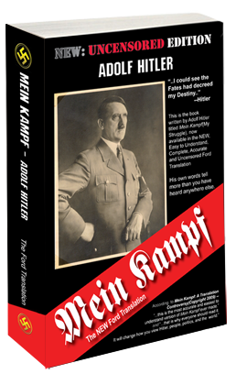
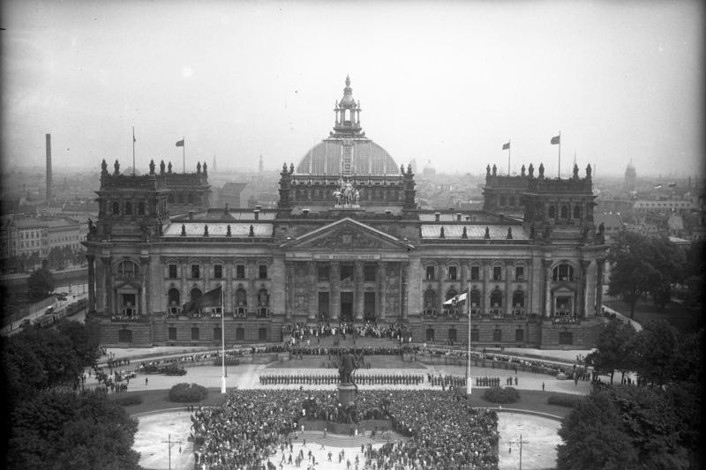
Hitler fought for Germany in WWI
-wrote “Mein Kampf” (My Struggle) in 1923
-As economic conditions grew worse (Great Depression-lose of territory, overseas investment, trade restrictions, reparations), more people voted for Nazi representatives in the Reichstag (German Parliament) -Why?

Slide 15
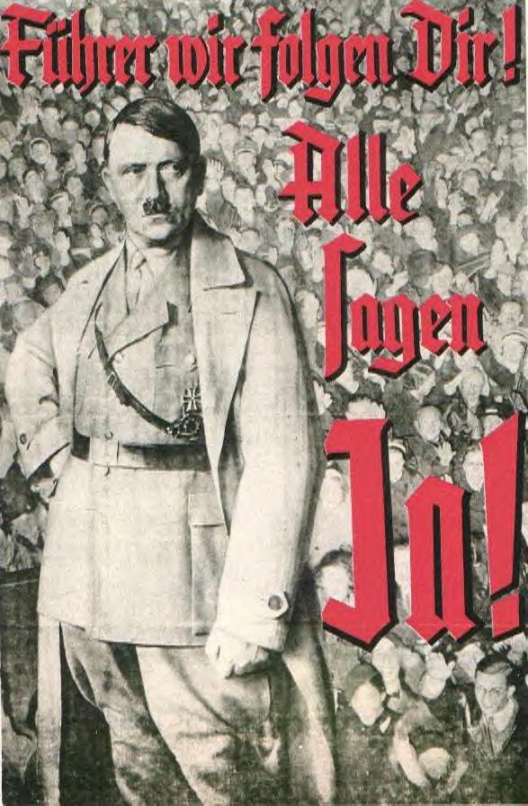
"Leader we will follow you!”
“We all say yes!"

