Slide 1
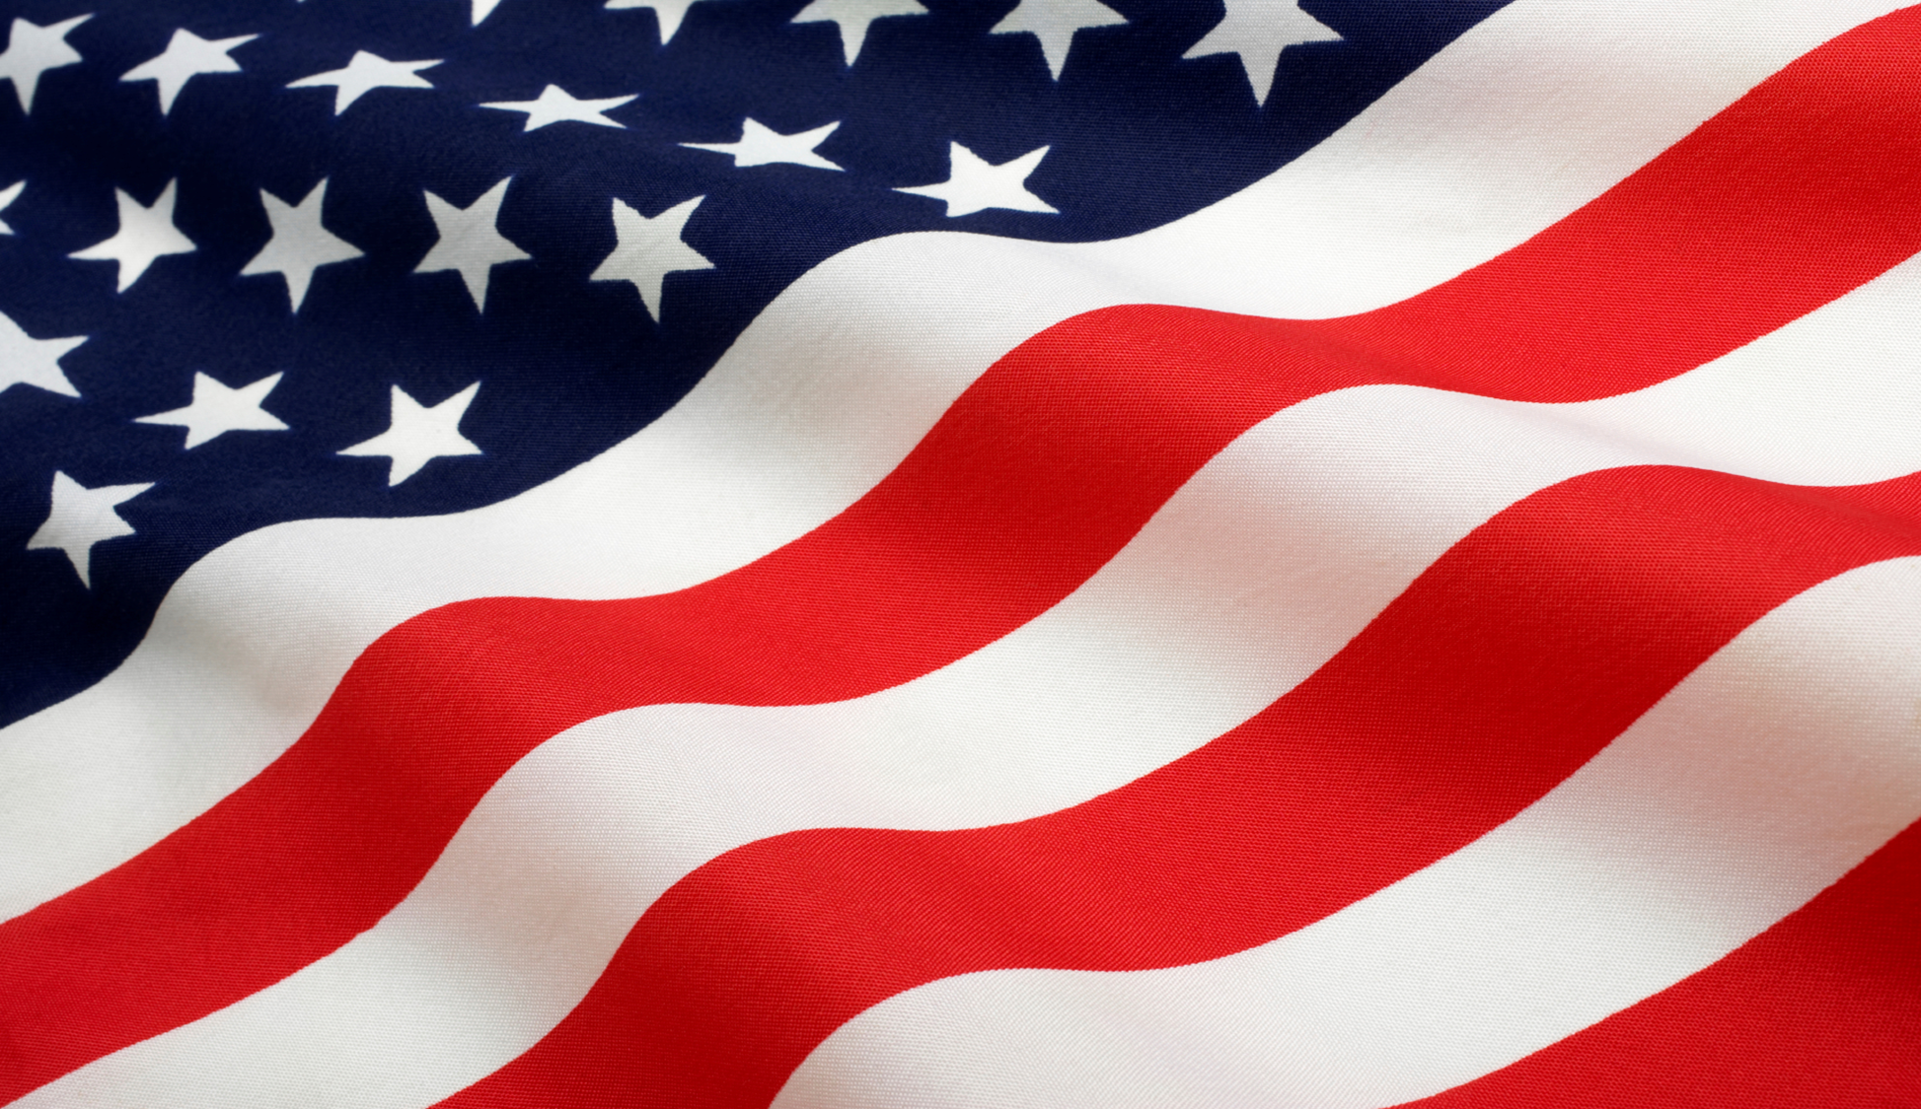

Slide 2
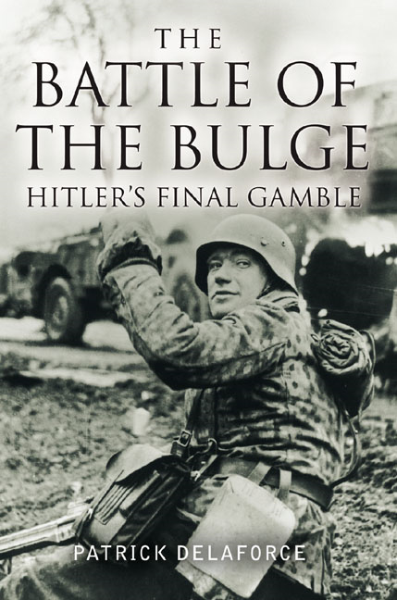
Invasion of France (Normandy) by Allies-June 6, 1944 D-Day
August 25, 1944 Paris freed from Nazi Rule
4. May 7, 1945-Allies invade Germany from the West, Russia from the East
-Battle of the Bulge (12/44-1/45 Go through protective Rhineland)-last Germany offensive. Allies capture Berlin, Hitler commits suicide, and Germany surrendered (5/8/45)

Slide 3
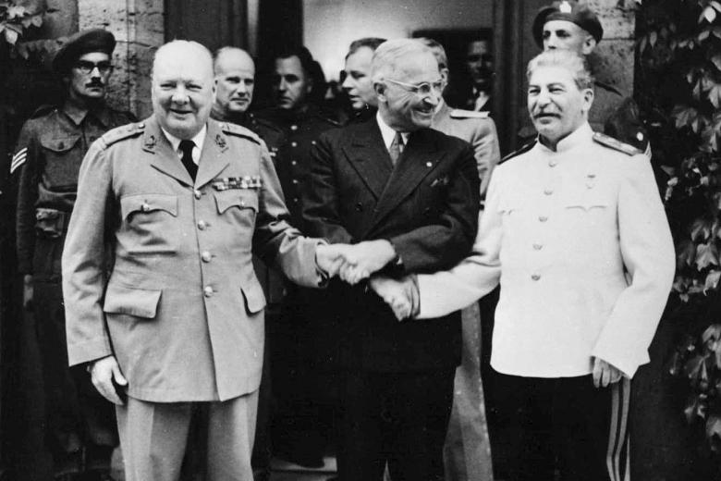
5. U.S. secretly tests the atomic bomb-Truman wanted to save American lives (would lose 1 million if they invade)
-Potsdam Declaration was a statement issued on July 26, 1945 by Harry S. Truman that Japan must surrender or face “utter and prompt destruction”. Japan had no idea what the U.S. had
-8/6/45 1st bomb dropped on Hiroshima-“Little Boy”-100,000 killed instantly, 100,000 more from injury and radiation-no surrender
-8/9/45 2nd bomb “Fat Man” dropped on Nagasaki-80,000 killed -Emperor Hirohito surrenders
9/2/45 Japan signs peace treaty
*over 60 million dead

Slide 4
EFFECTS OF WORLD WAR II
1. Nuremberg War Crimes Trials 11/45-9/46
-Nazi leaders are put on trial for “crimes against humanity”-responsible for the Holocaust.
-The defense of “following orders” is not accepted-Holocaust represents the ultimate act of “violating human rights”
-22 Nazis on trial-12 convicted & hanged-7 get life imprisonment

Slide 5
EFFECTS OF WORLD WAR II
2. UNITED NATIONS IS FORMED -meet in San Francisco
-Established in 1945-led by the Big Five - U.S., Russia, China, G.B., France
51 original members, now 185
Purpose:
-International peace keeping org.
-Settle disputes peacefully around the world
-Promote cooperation on economic, political & humanitarian issues
-As of November 2005, 107 countries were contributing a total of more than 70,000 uniformed personnel—the highest number since 1995.

Slide 6
EFFECTS OF WORLD WAR II
3. EUROPEAN DOMINATION ENDS
-France and Great Britain are no longer the super powers -wars took a toll, empires got smaller (lost colonies)
-U.S. & U.S.S.R become the new superpowers
Occupied nations-W. Germany and Japan -western nations/democracy
E. Germany and Eastern Europe USSR/communism
Europe divided in two-between democracy in the West and Communism in East

Slide 7
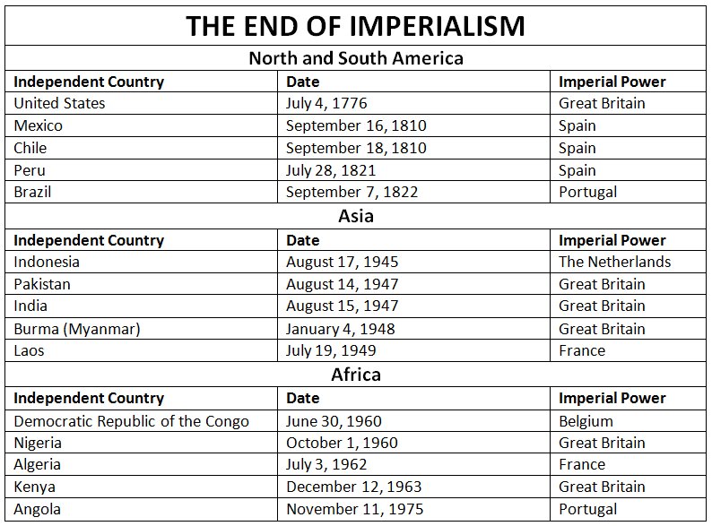
EFFECTS OF WORLD WAR II
4. COLONIAL NATIONALISM
-Imperial powers could no longer keep colonies - weakened by war

Slide 8
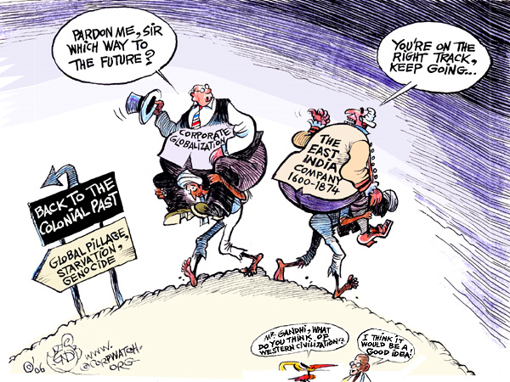

Slide 9
The Holocaust
One of Hitler’s goals was to create “living space” for Germans who he considered racially superior. He planned to destroy people he found inferior. Jews were the main target, but he also wanted to destroy or enslave others, including Slavs, Gypsies, and the mentally or physically disabled.

Slide 10
The Holocaust
The attempt to destroy an entire ethnic or religious group is called genocide. Hitler committed genocide against the Jews. He began by limiting the rights and encouraging violence against Jews. On November 8, 1938, called Kristallnacht "Crystal Night", organized violence began. Thousands of Jewish synagogues, businesses, cemeteries, schools, and homes were destroyed. The next day 30,000 Jews were arrested for being Jewish and more restrictive laws on Jews and Jewish businesses began. Jews were forced to live in separate areas. Finally, Hitler set up concentration camps. At death camps, like Auschwitz, Jews were starved, shot, or gassed to death. By 1945, over 6 million Jews died in what became known as the Holocaust.

Slide 11
Other Wartime Atrocities
Several other incidents, however, also stand out as especially brutal aspects of World War II.
• The Japanese invasion of Nanjing in 1937 involved mass shooting and terrible brutality. As many as 250,000 Chinese were killed
• In the Philippines, Japanese soldiers forced American and Filipino prisoners of war on a march up the Bataan peninsula. Along the way, prisoners were beaten, stabbed, and shot. This event is known as the Bataan Death March
• In Poland, Soviet troops subjected thousands of Poles to imprisonment, torture, and execution

Slide 12
