Slide 1
Unrest throughout Latin America

Slide 2
Source of Unrest throughout Latin America
Latin America is a diverse region with a great variety of peoples and cultures. Geographic barriers have discouraged unity, yet the nations of Latin America share similar problems. After World War II, political and social upheavals threatened stability in Latin America. Many Latin American nations looked to authoritarian leaders to provide solutions.

Slide 3
Cuba
Cuba had won independence from Spain in 1898. Over the next 60 years, Cuba was influenced by the United States. In 1952, Fulgencio Batista seized power. Under Batista the government was repressive and corrupt. Fidel Castro organized a guerrilla army and fought a war against Batista, gaining victory in 1959.

Slide 4
Cuba
Once in power, Castro established a communist dictatorship. Heavily supported by the Soviet Union, Cuba was a cold war battle ground until the collapse of communism in the Soviet Union and Eastern Europe. Cuba’s economy has since suffered greatly form the loss of its chief trading partners.

Slide 5
Mexico
After the Mexican Revolution, one party the Institutional Revolutionary Party (PRI) dominated Mexican politics for 71 years. Between 1960 and 2000 there were periods of upheaval. In 1986, students in Mexico protested. The police and military brutally suppressed the protests. In 1994, armed Indian Zapatista rebels demanded social and economic reforms. Many groups called for election reforms. In 200, the PRI lost and Vicente Fox from the National Action Party (PAN) was elected president.

Slide 6
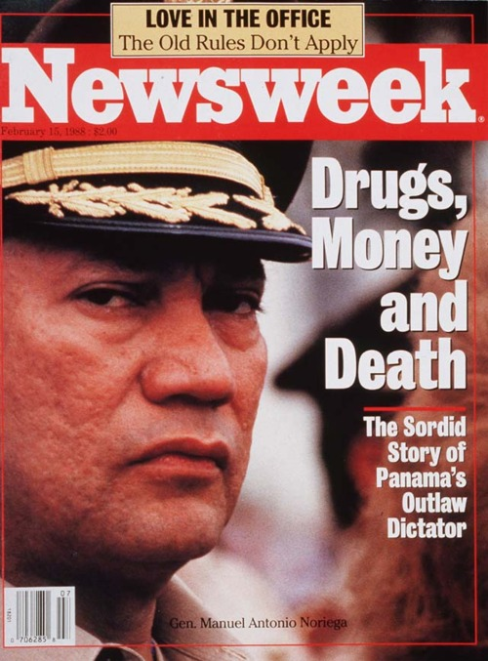
Panama
In the 1980s, the United States suspected that the leader of Panama, Manuel Noriega was helping drug lords smuggle drugs into the United States. US troops invaded in 1989 and arrested Noriega. Panama experienced greater stability in the 1990s.

Slide 7
North American Free Trade Agreement
In the 1990s, Mexico, the US, and Canada signed the North American Free Trade Agreement (NAFTA) which is a plan to allow free trade among the three nations by lowering trade barriers. Business and investment did come to Mexico, but other manufactures were hurt by competition.
Immigration provides a link between Mexico and the US. Since the 1970s, millions of Mexicans have migrated to the US, in search of better economic opportunities.

Slide 8
Political and Economic change in Latin America

Slide 9
Argentina By 1900
Argentina was the richest nation in Latin America. The Great Depression of the 1930s devastated the country and a military coup brought Juan Perón to power in 1946. Perón appealed to Argentine nationalism by limiting foreign-owned businesses and by promoting import substitution, in which local manufacturers produced goods at home to replace imported products. Perón gained popularity by boosting wages, strengthening labor unions, and beginning social welfare programs however, this led to huge debts. In 1955 he lost power in a military coup.

Slide 10
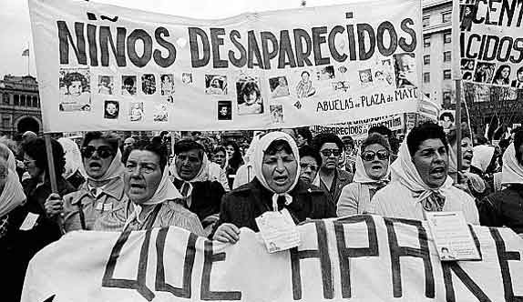
State Terrorism -Another military government took control in 1976. This government began a program of state terrorism against leftist guerrilla groups. The military arrested, tortured, and killed thousands of people. As many as 20,000 people simply “disappeared”, this is known as the dirty war.

Slide 11
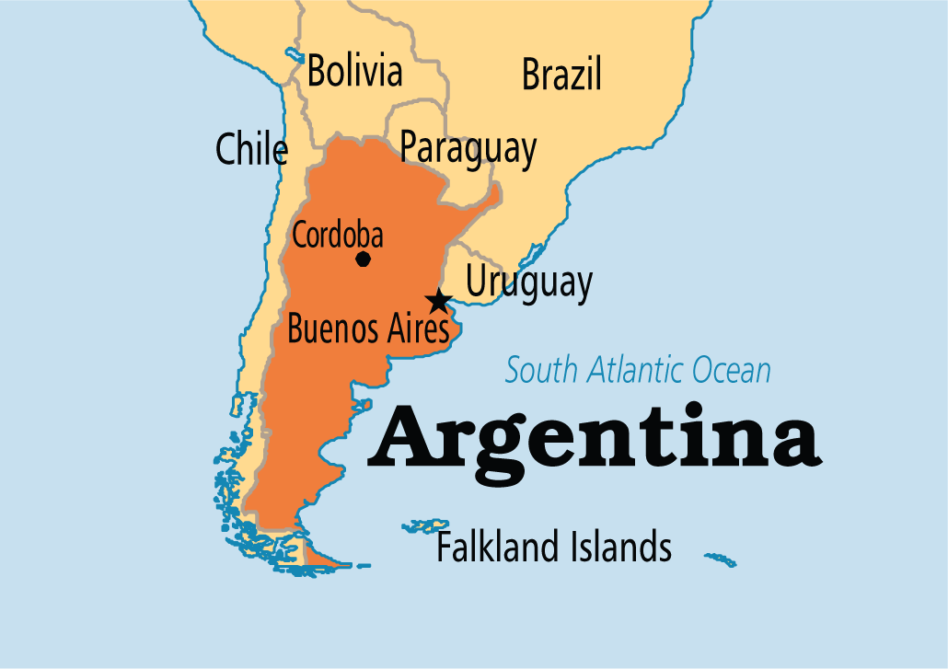
Democracy Restored –In 1983, Argentina held elections. Voters returned a democratic government to power. The new government worked to control the military and restore human rights. However, economic problems persisted. In 2001, and economic crisis rocked the nation and the hardship led to widespread protests and continued instability.

Slide 12
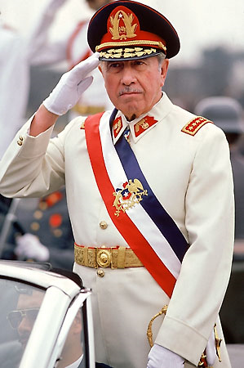
Chile
In 1970, Salvador Allende, a Communist, was elected president. He introduced land reform measures and nationalized copper mines, which were largely American-owned. In 1973, Allende was assassinated by the Chilean military, led by General Augusto Pinochet, who established a repressive military dictatorship.

Slide 13
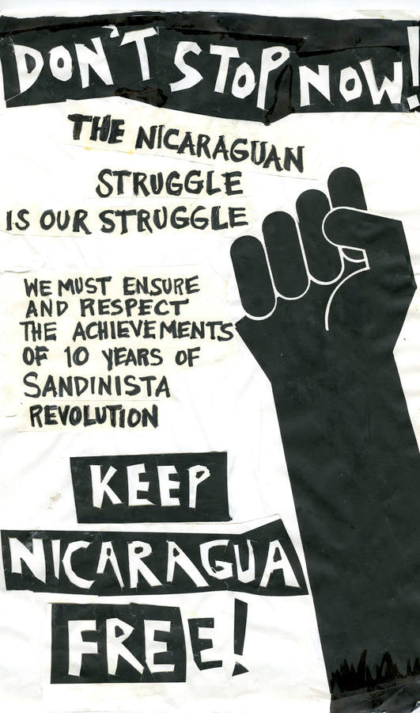
Nicaragua
The Somoza family governed Nicaragua. The Somoza’s were repressive but had close ties to the United States because of their anti-communist stance. In 1979, the Sandinistas, a group that included both reform-minded nationalists and communists, overthrew the Somoza government.

Slide 14
The Sandinistas in Power
The Sandinistas set up a government under the leadership of Daniel Ortega. The government introduced reforms while growing closer to Cuba and other communist nations. In the 1980s, the Sandinistas faced opposition form the contras, a counterrevolutionary group. The United States secretly backed the contras. Civil war followed, leading to many deaths and weakening the economy. Through compromises the Sandinistas handed over power to freely elected president, Violeta Chamorro. Nicaragua still had to rebuild its economy.

