Slide 1
WORLD WAR I

Slide 2
WORLD WAR I
WHAT WERE THE CAUSES OF WORLD WAR I
M -MILITARISM
A -ALLIANCES
I -IMPERALISM
N -NATIONALISM

Slide 3
MILITARISM-(glorification of military power)
The build up of strong armies and navies by the European nations
Safety would come from being stronger than your neighbor
Arms Race – a lot of money spent on arms -Germany is a war machine
ALLIANCES-Agreements made between nations for protection and in the interest of common goals (Collective security by being protected by other countries who would stick up for them) Starting in the 1890’s two alliance systems emerge in Europe. Countries trying to maintain a balance of power.

Slide 4
ALLIANCES
1. TRIPLE ALLIANCE (CENTRAL POWERS)
-GERMANY
-AUSTRIAN-HUNGARY
-ITALY
OTHERS: TURKEY, BULGARIA
2. TRIPLE ENTENTE –Friendly understandings (ALLIED POWERS)
-GREAT BRITAIN
-FRANCE
-RUSSIA
OTHERS: ITALY (switches 1914-does not honor alliance)
United States joins in 1917

Slide 5
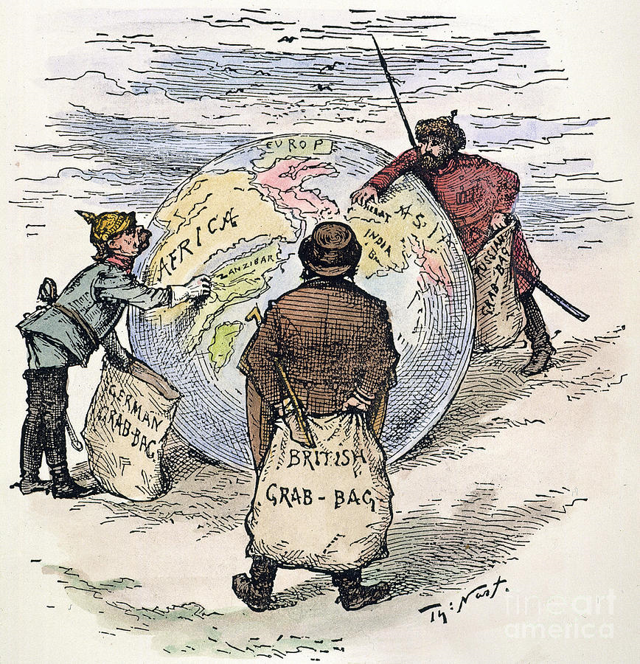
IMPERALISM-Imperial rivalries (Economic Rivalries)
Nations of Europe are competing for territories’ outside their borders in other parts of the world
(Balkans) **Russia and Austria-Hungry become rivals for the Balkans –Foreign interest and desire for its own unified country (POWDER KEG)

Slide 6
NATIONALISM- Having pride and patriotic feelings for your nation
SELF DETERMINISM–Wanting to govern yourself and achieve what’s in your best interests
-Serbs and Slavic people of Eastern Europe wanted unity and independence –Pan Slavism
-Russia sees itself as “protector” of the Balkans

Slide 7
THE SPARK
Immediate cause in 1914, Austrian Archduke Franz Ferdinand (heir to Austrian throne) and his wife were visiting Sarajevo, the capital of Bosnia and Herzegovina. Ferdinand and his wife are assassinated by a Serb (from the Balkans).
THE SPARK that set off the POWDER KEG.

Slide 8
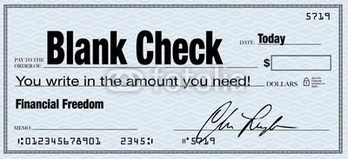
Austria sent Serbia an ultimatum (final set of demands).
Kaiser William II was horrified at the assassination of a royal heir.
Kaiser William advised Austria to take a firm stand toward Serbia and assured Austria of German support.
Thus, instead of urging restraint, the Kaiser gave Austria a “BLANK CHECK”.

Slide 9
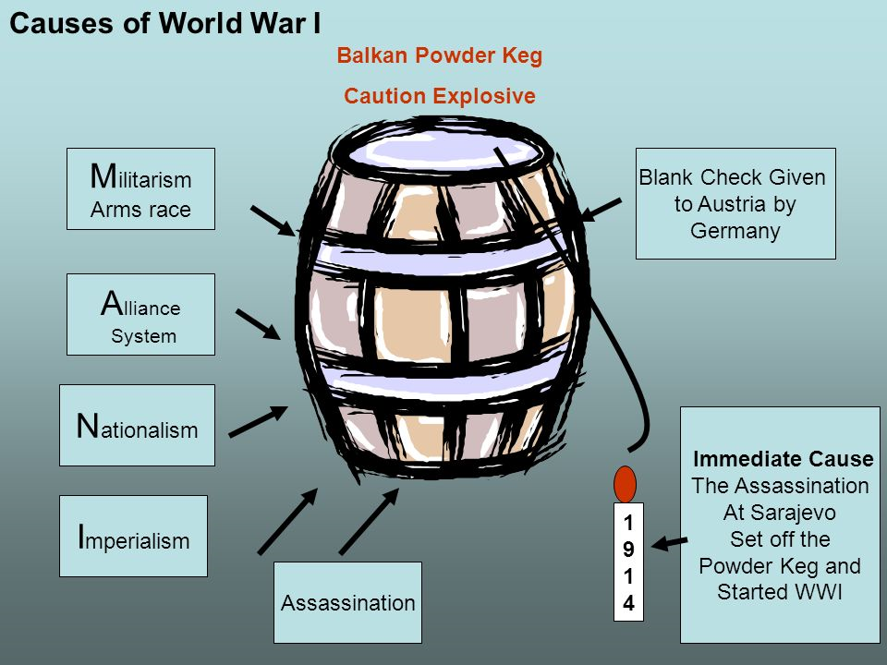

Slide 10
Military power seen as symbol of national prestige
Glorification of war by all powers
Arms race among great powers
Influential military leaders
Believe in Social Darwinism
Agreements among nations to aid each other if attacked
Russian agreements with smaller Slavic nations
Emergence of allies
Emergence of Central Powers
Militarism
Alliances
CAUSES OF
WORLD WAR I

Slide 11
CAUSES OF
WORLD WAR I
Imperialism
Nationalism
British concern over German growth
British concern over German competition for colonies
Economic rivalries among Britain, Germany and France
British and French desire to contain German territorial claims in Africa
French revenge against Germany
French desire for return of Alsace and Lorraine
Pan-Slavism in Eastern Europe
German pride in military power and industrial growth
Serbian desire to create south Slav state

Slide 12
CHAIN REACTION
1. Austria-Hungry blamed Serbia for the murders
2. Serbia refused to comply with the demands
3. Austria-Hungry declares war on Serbia on July 28
4. Russia, a Slavic nation and friend to Serbia, mobilized it forces
5. Germany, an ally of Austria-Hungry, declared war on Russia
6. Germany declared war on France, an ally of Russia
7. Germany invaded Belgium on August 3, 1914, so that Germany forces could enter France more easily
8. Britain declared war on Germany.

Slide 13
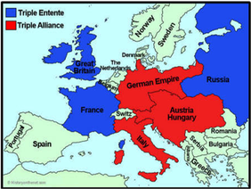
**Italy declined to enter because it saw the Central Powers as the aggressor. Italy will join the Allies in 1915 because it hoped to gain Austrian land.

Slide 14
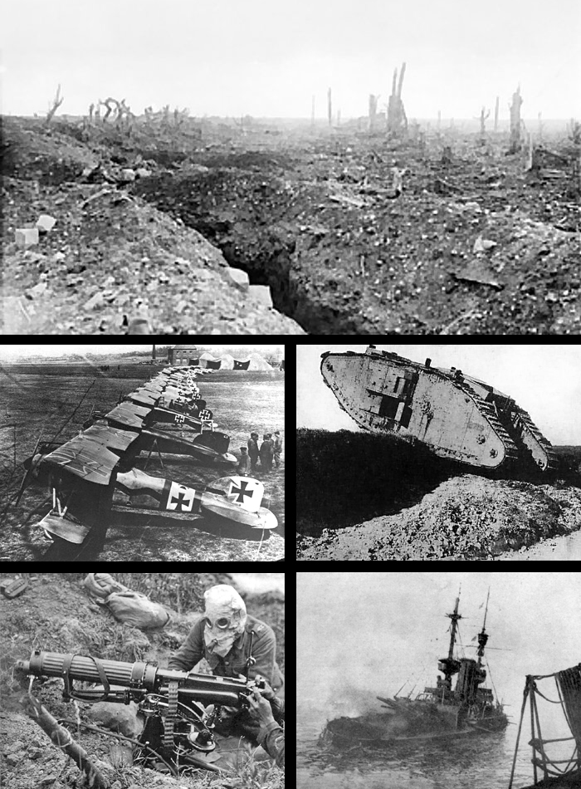
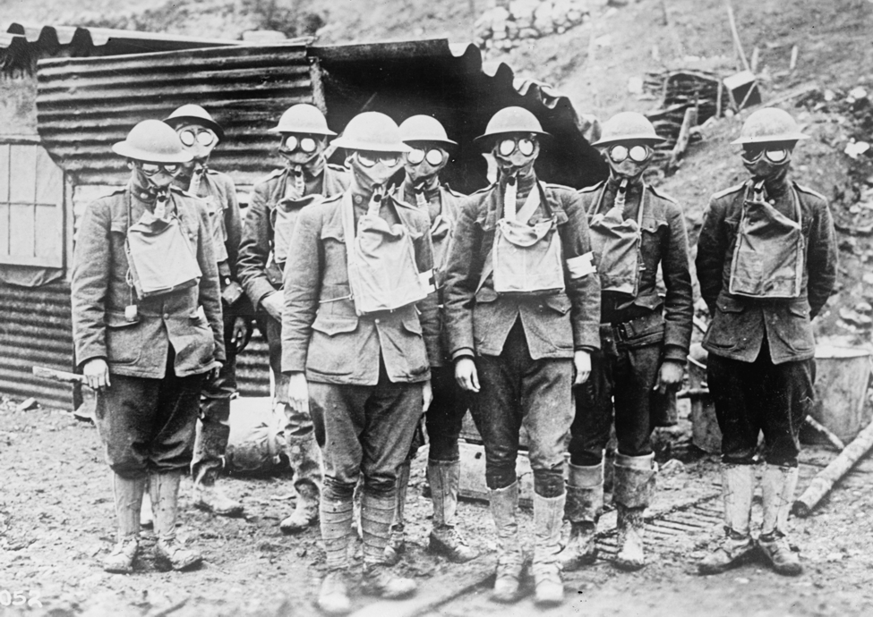
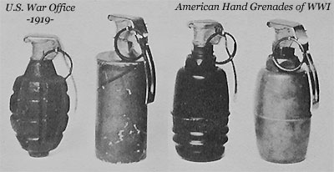
CHARACTERISTICS OF WWI
1. First War to use machine guns, poison gas, grenades, mortars, cannons, U-boats (submarine) and tanks.
All military technology from the INDUSTRIAL REVOLUTION

Slide 15
CHARACTERISTICS OF WWI
Much of the War was fought in TRENCH WARFARE 1914-1917
Both sides dig TRENCHES and fight across a piece of “NO MAN’S LAND” Which led to a STALEMATE for 4 years.
GERMANY IS FORCED TO FIGHT THE WAR ON 2 FRONTS
EASTERN FRONT=RUSSIA
WESTERN FRONT=FRANCE

